Slide 1
Removing smoke and haze for rescue operations

Slide 2
01
02
Table of Contents
03
04
Problem Statement
Describe the topic here
Proposed Solution
Describe the topic here
Use Case and Applications
Describe the topic here
Upscaling
Describe the topic here

Slide 3
01
PROBLEM STATEMENT

Slide 4
Smoke and haze in case of fire breakouts, severely reduce visibility, making it difficult for rescue teams to navigate through affected areas. This hampers the ability to locate and evacuate people, assess the extent of the fire, and coordinate firefighting efforts. While there exist other issues with the impact of smoke and haze, we aim to mitigate these very issues.
Problem Statement

Slide 5
Problem Statement and Inspiration
Visibility Impairment
Reduced visibility makes it challenging for rescue teams to locate and identify victims in need of assistance.
Navigation
Limited visibility hampers the ability of rescue personnel to navigate through structures, terrain, or other affected areas. This can result in slower response times
ResQ
Coordination
Reduced visibility can hinder visual communication, making it harder for team members to stay connected, share information, and work together efficiently.
Execution
Limited visibility can impede the speed and efficiency of evacuations

Slide 6
02
PROPOSED SOLUTION

Slide 7
The purpose of this proposal is to introduce and implement a DL-based video stream dehazing technology embedded with a visual sensors to enhance visibility during fire rescue operations or unmanned surveillance operations. This solution aims to address the challenges posed by limited visibility, particularly in environments affected by smoke and haze. The solution also aids trains and locomotives to travel through foggy weather conditions.
Proposed Solution:
ResQvision

Slide 8
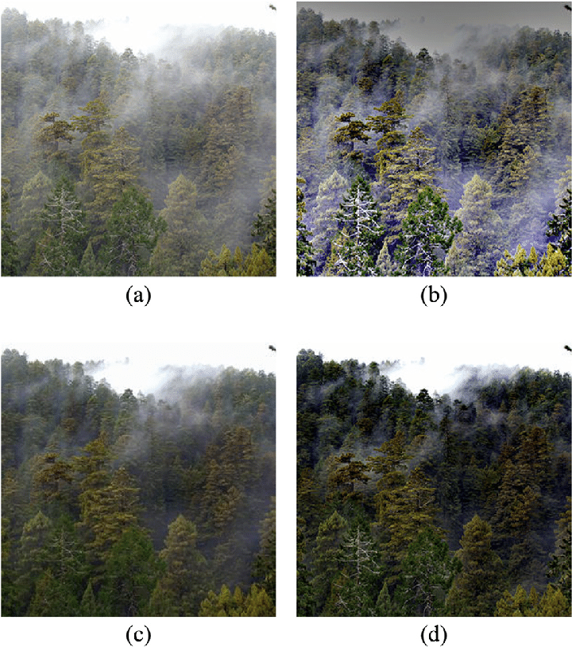
What we aim

Slide 9
03
PURPOSE & USE CASE

Slide 10
16,500+
Our purpose is efficient rescue operations, disaster management and mortality mitigation in the several fire-related mishaps.
Fire related mishaps in New Delhi (2022) alone

Slide 11
Use Cases
Manned Locomotive Assistance
Intelligent Vehicles
Disaster Response
Drone Surveillence
Wildfires
Manned Rescue

Slide 12
04
UPSCALING

Slide 13
Upscaling Potential
New Equipment
Efficient use of this tech, opens avenues for new age standard products in rescue operations, by making this the new standard.
Ease of Use
While we aim to develop a working prototype currently, future upscaling potential for this product is greatly dictated by lightweight and minimally invasive equipment.
Remote Reckon
In cases if wildfires and fires
In industries, where manned missions are risky, remote reckon will be greatly aided by a dehazed video stream.
Cost Reduction
By making use of technologies like 3D printing and efficient design processes, we aim to minimize cost, all while upholding product usability.

Slide 14
Citations/Research Referred
Find the research paper linked right here.

Slide 15
Thanks!
Presented to you by:
1.Shirsho Das Roy(121EI0655)
2.Megh Desai(121EI0651)
3.Shubham Kumar(121EI0909)
4.Roshan Raj(121EI0411)
5.Ashish Lugun (121EI0910)
Please keep this slide for attribution

